Slide 1
MCECS Guide Robot Project
Project Update
5/23/2012

Slide 2
Agenda
Goal
Progress Report
  System Diagram
  Base (Omar Mohsin, Ali Alnasser)
  Body (David Gaskin)
  Head/Neck (Stephen Huerta)
  Arm (James )
  Vision (Danny Voils, Mathias Sunardi)
  Natural Language Processing (Robert Fiszer)
To Do List

Slide 3
Goal
Demo towards the end of Spring Term 2012:
  Base, body, and head assembled.
  Robot can move around the Engineering Building atrium autonomously or by remote.
  Robot can avoid obstacles and/or collision with obstacles.
  Robot can display simple gestures.
  Few simple interactions.

Slide 4

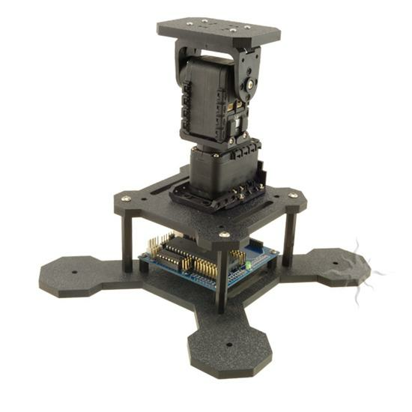
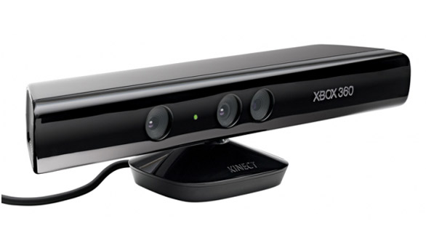
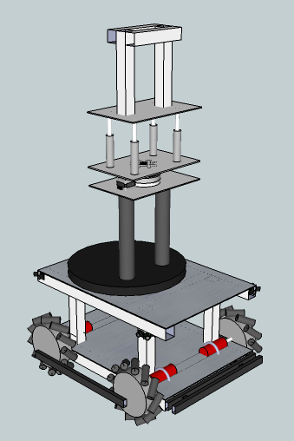
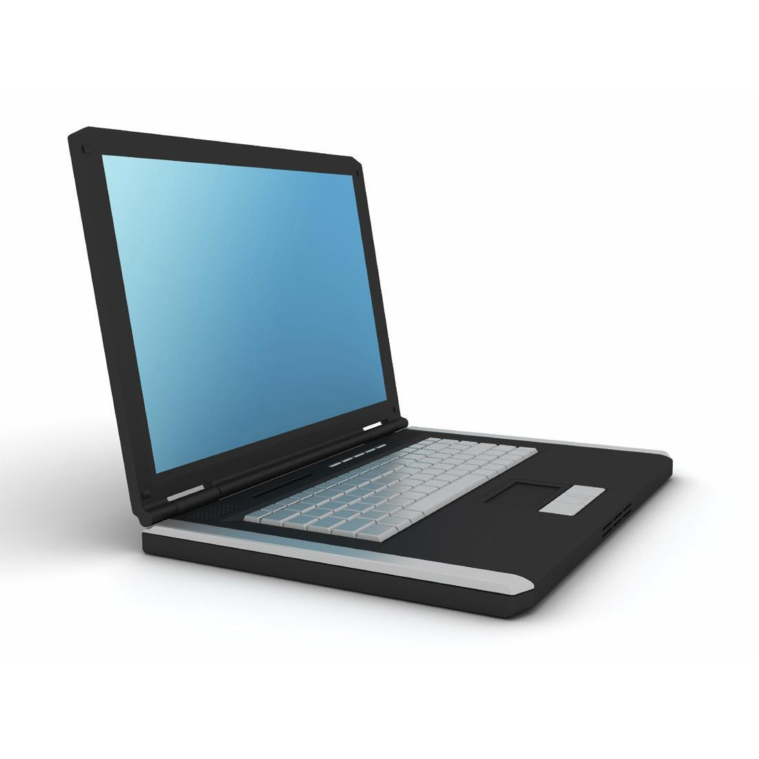
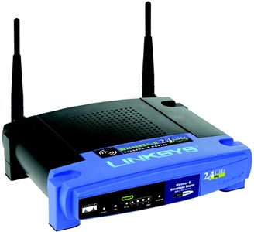
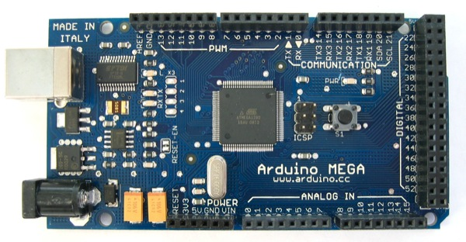
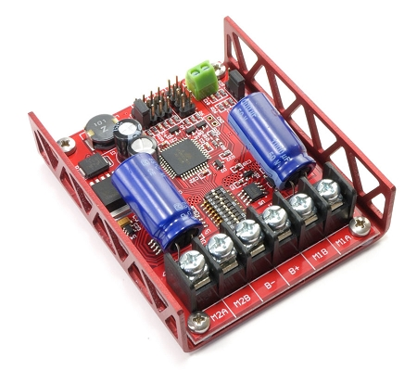
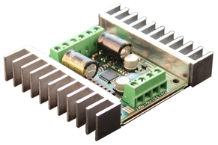
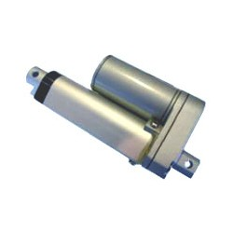
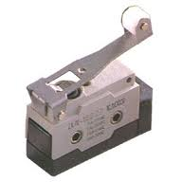
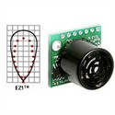
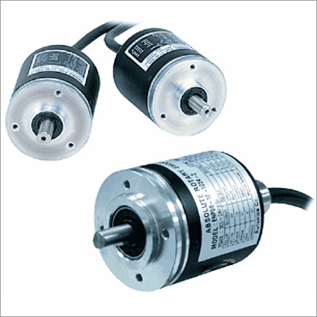
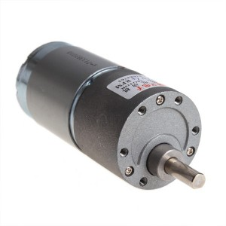
System Diagram
Tablet/Head
(UI)
Neck
Kinect
(Vision)
ArduinoMEGA
Microcontroller
Body
+
Base
Router
PC
Motor Controllers
Sensors On Base
DC Motors
(Wheels)
Linear Actuators
(Waist)
Limit Switch
(Bumpers)
Sonar
(Proximity)
Rotary Encoders

Slide 5
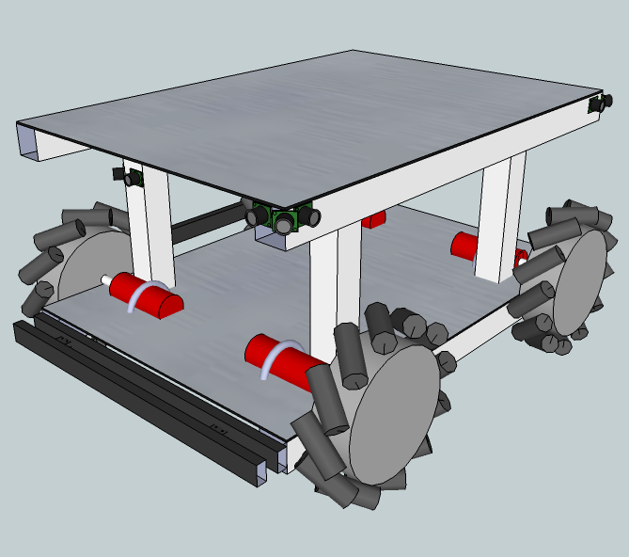
Base

Slide 6
Base
Omar Mohsin, Ali Alnasser
Avoids obstacles
Navigate safely
Storage:
  Battery
  PC
  Base & body motor controllers
Bumpers to detect collisions
PC
ArduinoMEGA
Microcontroller
Limit Switch
(Bumpers)
Sonar
(Proximity)
Rotary Encoders
DC Motors
(Wheels)

Slide 7
Base
Progress/Current State:
  Encoders, batteries, battery charger, power management board, limit switches have been purchased.
  Battery selected for ~2 hours (normal operation).
  Testing to determine best proximity/obstacle avoidance policy.
  Waiting for motor controllers.
PC
ArduinoMEGA
Microcontroller
Limit Switch
(Bumpers)
Sonar
(Proximity)
Rotary Encoders
DC Motors
(Wheels)

Slide 8
Base
Controllers
  PC
  ArduinoMEGA
  Motor Controller
Sensors:
  Limit Switch (x8)
  Sonar (x12)
  Rotary Encoders (x4)
Actuators:
  DC Geared Motor (x4)
ArduinoMEGA
Microcontroller
PC
Limit Switch
(Bumpers)
Sonar
(Proximity)
Rotary Encoders
DC Motors
(Wheels)

Slide 9
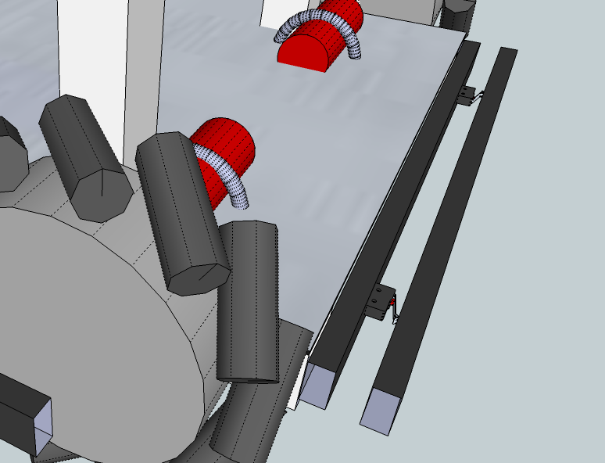
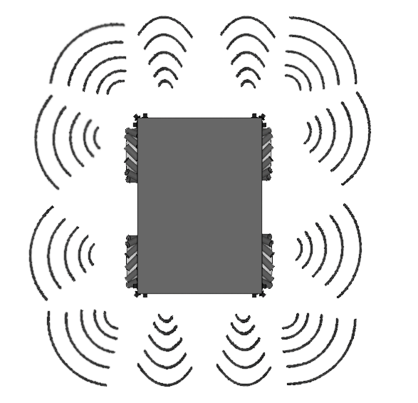
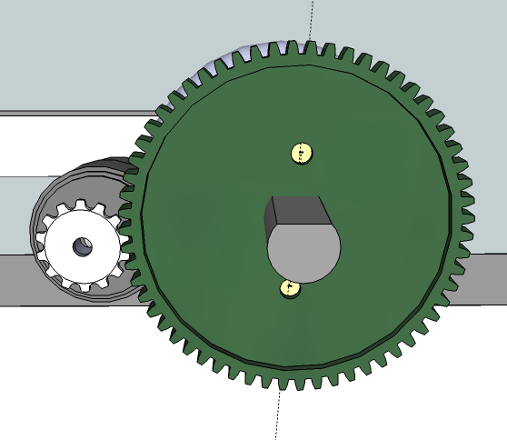
Base
Motor Controller:
  Controls wheels
  Rotary Encoders
  Closed-loop PID controller
Obstacle detection:
  Limit Switch for bumpers (emergency stop on collision).
  Sonar for obstacle detection & avoidance (15cm - ~6m range).

Slide 10
Body
David Gaskin
4 Degrees of Freedom for expressive body gestures, dance motion, etc.
  Tilt
  Rotation
Base for:
  Head
  Arms
  Kinect
  User Interface (tablet, buttons, lights, speakers)
ArduinoMEGA
Microcontroller
PC
Linear Actuators
(Waist)

Slide 11
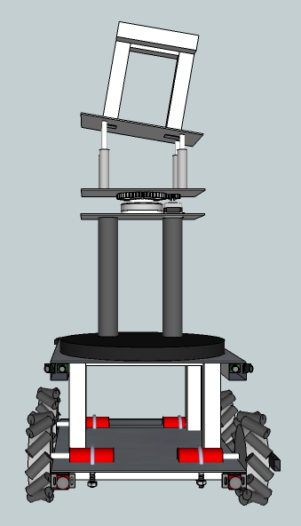
Body
Progress/Current State:
  Calculations on range of motion.
  Working on determining top joint design.
  Programming position control.

Slide 12
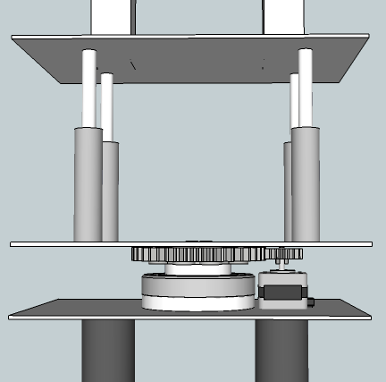
Body
Controllers:
  ArduinoMEGA
  Sabretooth motor driver
Sensors:
  Encoder (built-in in actuators)
Actuators:
  Linear Actuators (x4)
  Stepper motor (x1) (not implemented yet)
ArduinoMEGA
Microcontroller
PC
Linear Actuators
(Waist)

Slide 13
Head/Neck
Stephen Huerta
Neck:
  2 Degrees of freedom: tilt and pan.
Head:
  Cartoon face on tablet device.
  User Interaction.
  Display responses.
PC

Slide 14
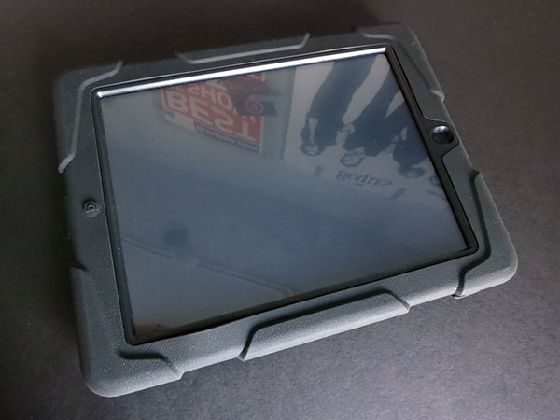
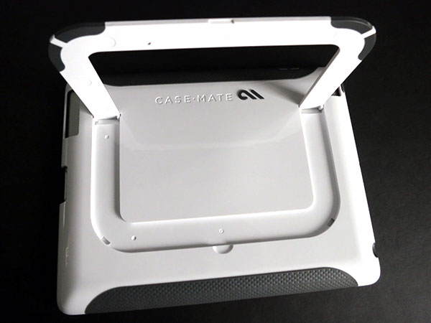
Head/Neck
Progress/Current State:
  Early testing for motor controls.
  Research into tablet holder.
  Research into tablet programming (iOS).

Slide 15
Head/Neck
Controllers:
  Arbotix
Actuators:
  Bioloid servos (x2)

Slide 16

Head/User Interface (concept)
Microphone/Camera inputs (possibility)
Gives users text and visual feedback
Manual input feedback for users

Slide 17
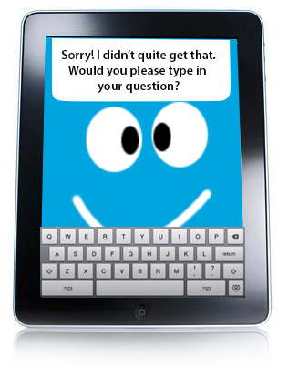
Head/User Interface (concept)
Microphone/Camera inputs (possibility)
Gives users text and visual feedback
Manual input feedback for users

Slide 18
Arm
(James’ part)
PC

Slide 19
Vision
Mathias Sunardi, Danny Voils
Object detection/recognition
Face detection/recognition
Navigation/localization
Kinect
(Vision)
PC

Slide 20
Vision
State:
  Mathias Sunardi is working with Danny Voils to use images from Kinect for object recognition based on Danny’s thesis work.
  Mathias Sunardi is working on hallway-vanishing-point detection for navigation.
Kinect
(Vision)
PC

Slide 21
Natural Language Processing
Status:
  No update.

Slide 22
Navigation
Status:
  No update.

Slide 23
To Do
Assemble sensors on base and test.
Determine safety policies for:
  Navigation (avoid collision, stairs, walls)
  Components (avoid damages to actuators, power system, controllers)
Assemble base with upper body
Construct upper body for base of neck and arm.
Design/programming User Interface
Mapping/navigation program
Main program to integrate all components

Slide 24
Questions?

Slide 25
Extra Slides …

Slide 26
Head/Neck

Slide 27
Head/Neck

Slide 30
